Slide 1
Module-4 Network Layer IP addressing schemes, IPV4, Subnetting, IPV6, shift from IPV4 to IPV6
Dr. R. Prashanth

Slide 2
Introduction
Internet Protocol (IP) is the method or protocol by which data is sent from one computer to another on the internet.
The development of the protocol gets started in 1974 by Bob Kahn and Vint Cerf. It is used in conjunction with the Transmission Control Protocol (TCP), so they together named the TCP/IP.
It is a protocol defined in the TCP/IP model used for sending the packets from source to destination.
The main task of IP is to deliver the packets from source to the destination based on the IP addresses available in the packet headers.

Slide 3
Working of IP addresses
The working of IP addresses is similar to other languages. It can also use some set of rules to send information. Using these protocols we can easily send, and receive data or files to the connected devices. There are several steps behind the scenes. Let us look at them.
Your device directly requests your Internet Service Provider which then grants your device access to the web.
And an IP Address is assigned to your device from the given range available.
Your internet activity goes through your service provider, and they route it back to you, using your IP address.
Your IP address can change. For example, turning your router on or off can change your IP Address.
When you are out from your home location your home IP address doesn’t accompany you. It changes as you change the network of your device.

Slide 4
What is IP Addressing?
An IP address is a unique identifier assigned to the computer which is connected to the internet.
Each IP address consists of a series of characters like 192.168.1.2. Here each number in the set is from 0 to 255 range. Or we can say that a full IP address ranges from 0.0.0.0 to 255.255.255.255.
IP addresses are not random. They are mathematically produced and allocated by the Internet Assigned Numbers Authority (IANA), a division of the Internet Corporation for Assigned Names and Numbers (ICANN).
ICANN is a non-profit organization that was established in the United States in 1998 to help maintain the security of the internet and allow it to be usable by all.
Each time anyone registers a domain on the internet, they go through a domain name registrar, who pays a small fee to ICANN to register the domain.

Slide 5
An IP protocol provides the connectionless service, which is accompanied by two transport protocols, i.e., TCP/IP and UDP/IP, so internet protocol is also known as TCP/IP or UDP/IP.
The main function of the internet protocol is to provide addressing to the hosts, encapsulating the data into a packet structure, and routing the data from source to the destination across one or more IP networks.
In order to achieve these functionalities, internet protocol provides two major things:
Format of IP packet
IP addressing system

Slide 6
Types of IP Address Schemes
IP Address is of two types:
IPv4
IPv6

Slide 7
IPv4 Address
IP stands for Internet Protocol and v4 stands for Version Four (IPv4). IPv4 was the primary version brought into action for production within the ARPANET in 1983.
IP version four addresses are 32-bit integers which will be expressed in decimal notation.
Example- 192.0.2.126 could be an IPv4 address.
It consists of 4 numbers separated by the dots. Each number can be from 0-255 in decimal numbers. But computers do not understand decimal numbers, they instead change them to binary numbers which are only 0 and 1.
Therefore, in binary, this (0-255) range can be written as (00000000 – 11111111).

Slide 8
Since each number N can be represented by a group of 8-digit binary digits. So, a whole IPv4 binary address can be represented by 32-bits of binary digits.
In IPv4, a unique sequence of bits is assigned to a computer, so a total of (2^32) devices approximately = 4,294,967,296 can be assigned with IPv4.
The main difference between IPv4 and IPv6 is the address size of IP addresses. The IPv4 is a 32-bit address, whereas IPv6 is a 128-bit hexadecimal address.

Slide 9
IPv4 address is divided into two parts:
Network ID
Host ID
Subnet number

Slide 10
The network part indicates the distinctive variety that’s appointed to the network. The network part conjointly identifies the category of the network that’s assigned.
The host part uniquely identifies the machine on your network. This part of the IPv4 address is assigned to every host. For each host on the network, the network part is the same, however, the host half must vary.
Subnet part is the nonobligatory part of IPv4. Local networks that have massive numbers of hosts are divided into subnets and subnet numbers are appointed to that.

Slide 11
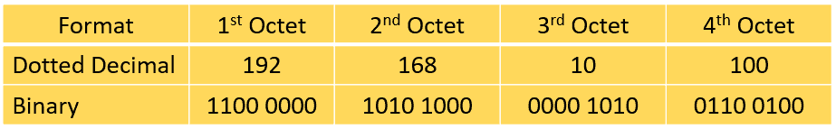
IPv4 addresses are expressed as a set of four numbers in decimal format, and each set is separated by a dot.
Thus, the term ‘dotted decimal format.’ Each set is called an ‘octet’ because a set is composed of 8 bits.
The figure below shows the binary format of each octet in the 192.168.10.100 IP address:
A number in an octet can range from 0 to 255. Therefore, the full IPv4 address space goes from 0.0.0.0 to 255.255.255.255. The IPv4 address has two parts, the network part and the host part. A subnet mask is used to identify these parts.

Slide 12
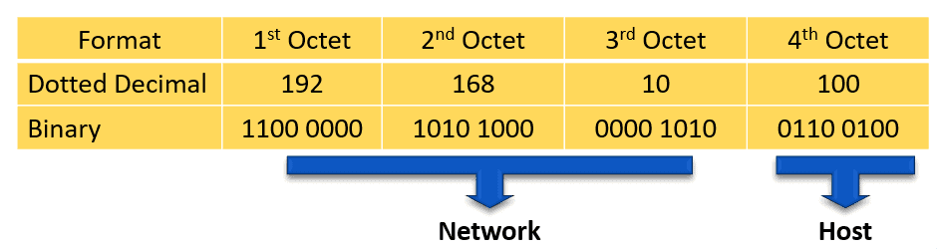
The network part of the IPv4 address is on the left-hand side of the IP address. It specifies the particular network to where the IPv4 address belongs. The network portion of the address also identifies the IP address class of the IPv4 address.
For example, we have the IPv4 address 192.168.10.100 and a /24 subnet mask. /24 simply means that the first 24 bits, starting from the left side, is the network portion of the IPv4 address. The 8 remaining bits of the 32 bits will be the host portion.
`

Slide 13
The host portion of the IPv4 address uniquely identifies the device or the interface on your network. Hosts that have the same network portion can communicate with one another directly, without the need for the traffic to be routed.
Subnet mask
The second item, which is required for TCP/IP to work, is the subnet mask. The subnet mask is used by the TCP/IP protocol to determine whether a host is on the local subnet or on a remote network.

Slide 14
So now you know, for this example using a 255.255.255.0 subnet mask, that the network ID is 192.168.123.0, and the host address is 0.0.0.132.
When a packet arrives on the 192.168.123.0 subnet (from the local subnet or a remote network), and it has a destination address of 192.168.123.132, your computer will receive it from the network and process it. Some of other subnet masks.
Decimal | Binary
255.255.255.192 | 1111111.11111111.1111111.11000000
255.255.255.224 | 1111111.11111111.1111111.11100000

Slide 15
Lining up the IP address and the subnet mask together, the network, and host portions of the address can be separated:
11000000.10101000.01111011.10000100 - IP address (192.168.123.132) 11111111.11111111.11111111.00000000 - Subnet mask (255.255.255.0)
The first 24 bits (the number of ones in the subnet mask) are identified as the network address. The last 8 bits (the number of remaining zeros in the subnet mask) are identified as the host address.
It gives you the following addresses:
11000000.10101000.01111011.00000000 - Network address (192.168.123.0) 00000000.00000000.00000000.10000100 - Host address (000.000.000.132)

Slide 16
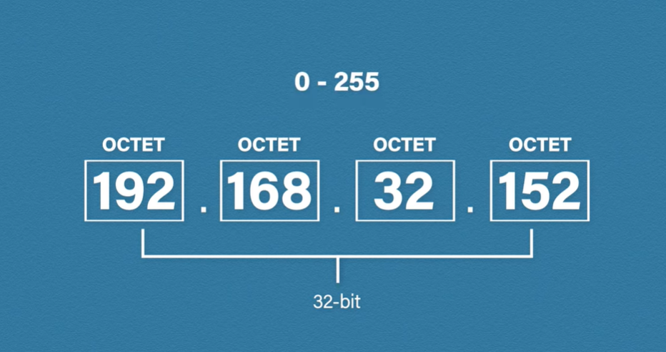

Slide 17
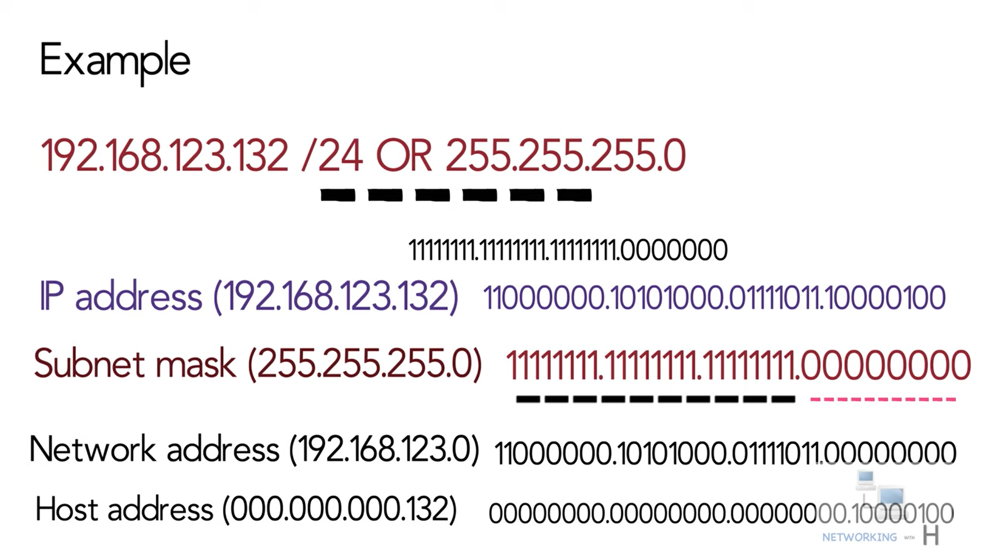

Slide 18
Network classes
Internet addresses are allocated by the InterNIC, the organization that administers the Internet. These IP addresses are divided into classes.
The most common of them are classes A, B, and C. Each of the address classes has a different default subnet mask. You can identify the class of an IP address by looking at its first octet.
Following are the ranges of Class A, B, and C Internet addresses, each with an example address
Classes D and E exist, but aren't used by end users.

Slide 19
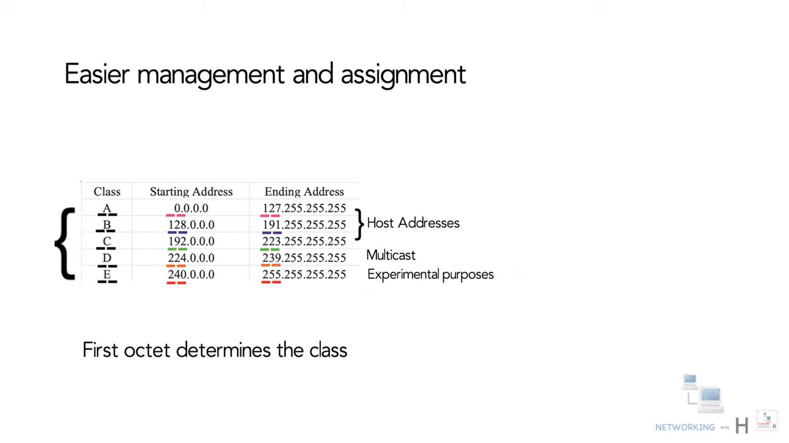

Slide 20
Class A networks use a default subnet mask of 255.0.0.0 and have 0-127 as their first octet. The address 10.52.36.11 is a class A address. Its first octet is 10, which is between 1 and 126, inclusive.
Class B networks use a default subnet mask of 255.255.0.0 and have 128-191 as their first octet. The address 172.16.52.63 is a class B address. Its first octet is 172, which is between 128 and 191, inclusive.
Class C networks use a default subnet mask of 255.255.255.0 and have 192-223 as their first octet. The address 192.168.123.132 is a class C address. Its first octet is 192, which is between 192 and 223, inclusive.

Slide 21
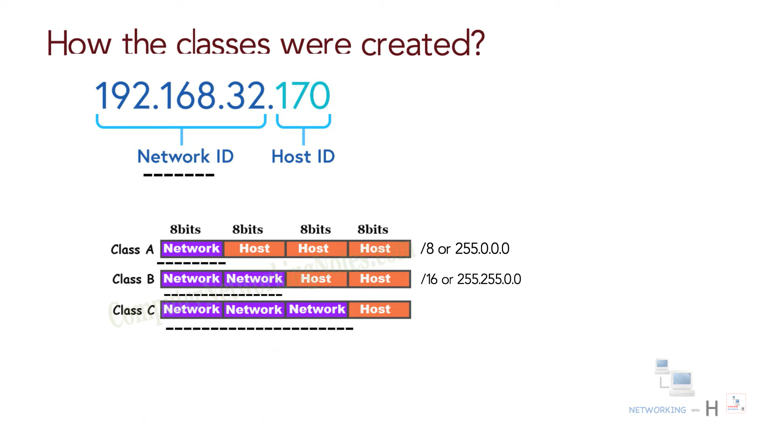

Slide 22
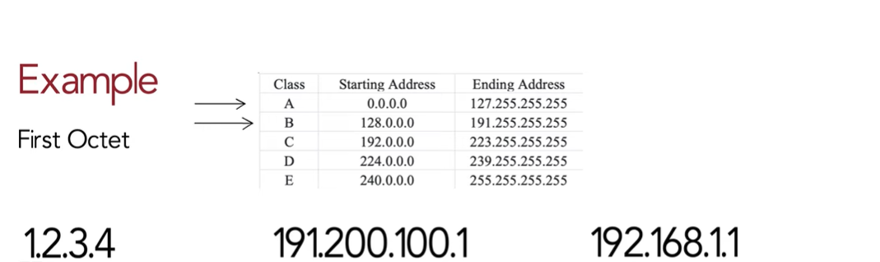

Slide 23
Rules for assigning Host ID:
Within any network, the host ID must be unique to that network.
Host ID in which all bits are set to 0 cannot be assigned because this host ID is used to represent the network ID of the IP address.
Host ID in which all bits are set to 1 cannot be assigned because this host ID is reserved as a broadcast address

Slide 24
Rules for assigning Network ID:
The network ID cannot start with 127 because 127 belongs to class A address and is reserved for internal loop-back functions
All bits of network ID set to 1 are reserved for use as an IP broadcast address

Slide 25
Characteristics of IPv4
IPv4 could be a 32-Bit IP Address.
IPv4 could be a numeric address, and its bits are separated by a dot.
The number of header fields is twelve and the length of the header field is twenty.
It has Unicast, broadcast, and multicast style of addresses.
IPv4 supports VLSM (Virtual Length Subnet Mask).
IPv4 uses the Post Address Resolution Protocol to map to the MAC address.
RIP may be a routing protocol supported by the routed daemon.
Networks ought to be designed either manually or with DHCP.
Packet fragmentation permits from routers and causing host.

Slide 26
Limitations of IPv4
IP relies on network layer addresses to identify end-points on network, and each network has a unique IP address.
The world’s supply of unique IP addresses is dwindling, and they might eventually run out theoretically.
If there are multiple host, we need IP addresses of next class.
Complex host and routing configuration, non-hierarchical addressing, difficult to re-numbering addresses, large routing tables, non-trivial implementations in providing security, QoS (Quality of Service), mobility and multi-homing, multicasting etc. are the big limitation of IPv4 so that’s why IPv6 came into the picture.

Slide 27
Subnetting
When the IP system was first introduced, finding a network and sending data to it was easier because the number of users on the internet was limited.
As the number of users on the internet is increasing, sending a data packet to the computer you want in a network is becoming quite difficult these days.
When a network is large enough to support an organization, network performance becomes a significant concern.
An organization can use IP subnets to split more extensive networks for logical (firewalls, etc.) or physical reasons (smaller broadcast domains, etc.). In other words, routers make routing decisions based on subnets. In this article, we will learn these concepts more briefly.

Slide 28
Subnetting is a method of dividing a single physical network into logical sub-networks (subnets).
Subnetting allows a business to expand its network without requiring a new network number from its Internet service provider.
Subnetting helps to reduce the network traffic and also conceals network complexity.
Subnetting is necessary when a single network number must be assigned to several portions of a local area network (LAN).

Slide 29
A subnet, sometimes known as a subnetwork, is a part of a larger network. Subnets are the logical division of an IP network into many smaller network parts.
To reduce traffic, a subnet's purpose is to divide a huge network into a collection of smaller, interconnected networks. Subnets eliminate the need for traffic to pass through extraneous routs, resulting in faster network speeds.
Subnets were created to alleviate the shortage of IP addresses on the internet.

Slide 30
Example
Subnetting divides the network into small subnets. Routers are used to communicate between subnets, whereas each subnet allows its linked devices to communicate with each other.
The size of a subnet is determined by the network technology used and the connection needs.
A Network Prefix (also known as the Network ID) and a Host ID are the two fields that make up an IP address. Whether the Network Prefix and the Host ID are separated depends on whether the address is Class A, B, or C.

Slide 31
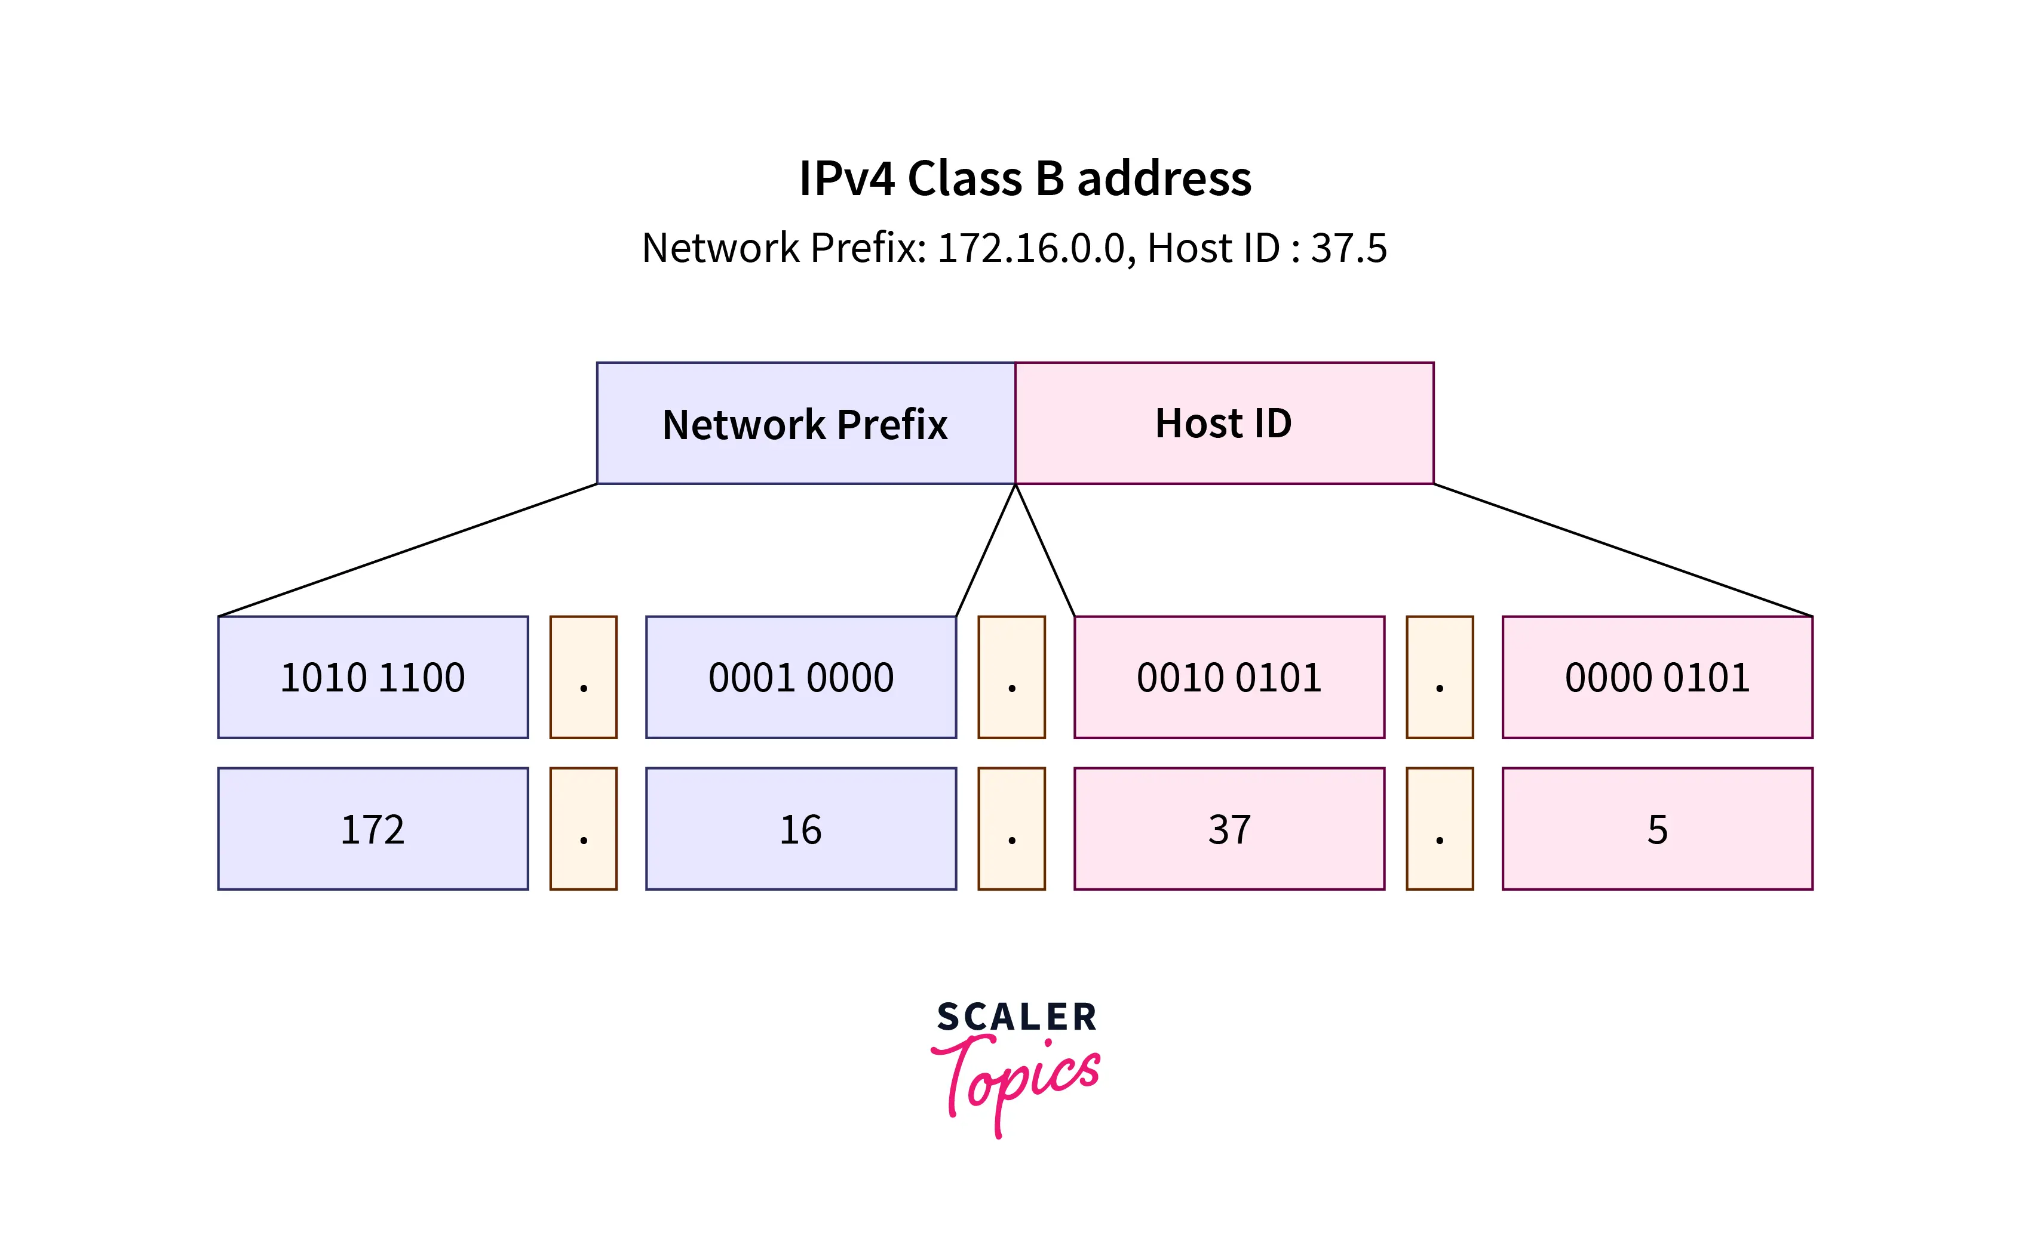
The figure given below shows a 172.16.37.5 IPv4 Class B address. The Host ID is 37.5, and the Network Prefix is 172.16.0.0.

Slide 32
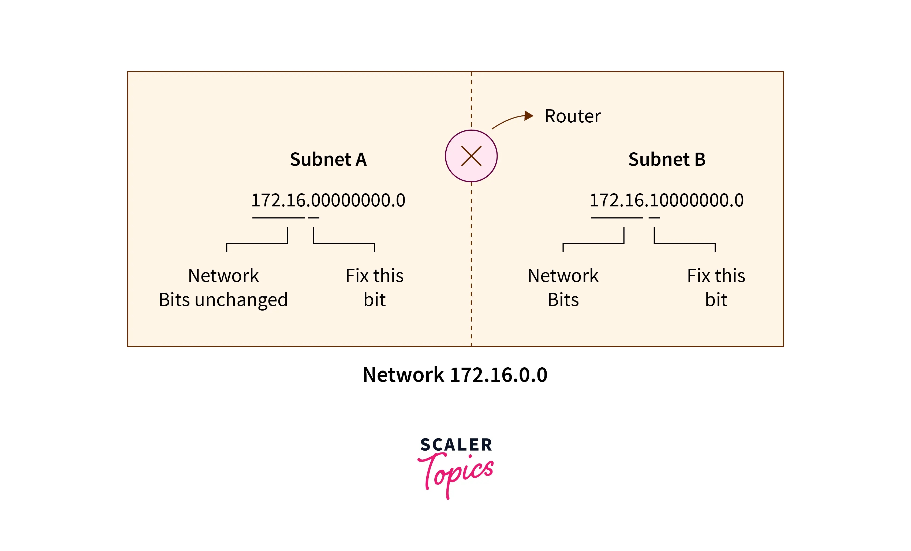
Now, we generally fix MSB(Most Significant Bit) bits of the Host ID to generate the subnets. In the figure below, we fix one of the host's MSB(Most Significant Bit) bits to generate two network subnets. We cannot change network bits because if we change network bits, the whole network is changed.

Slide 33
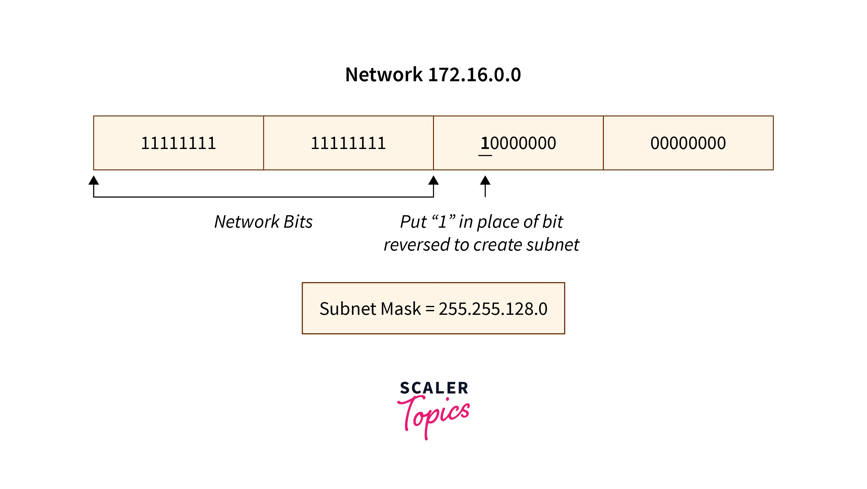

Slide 34
Example
To understand subnetting better let's look at a simple scenario. A college has four departments: Information Technology, Computer Science, Mechanical, and Civil.
There are 50 students in each department. The institution used a class C IP network(with network ID 192.168.1.0).
All computers will work in a single huge network if there is no subnetting. It becomes complex for the institution admin to handle the task because if he broadcasts some message to the system, it will forward to all the departments.
To solve this type of problem, we use subnetting.

Slide 35
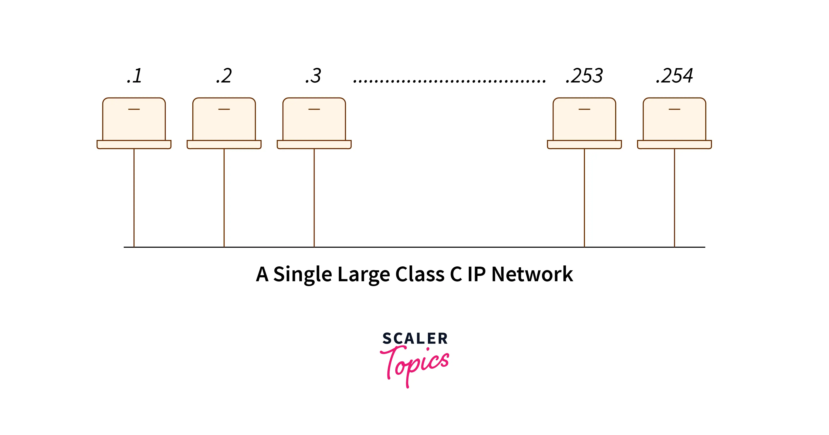

Slide 36
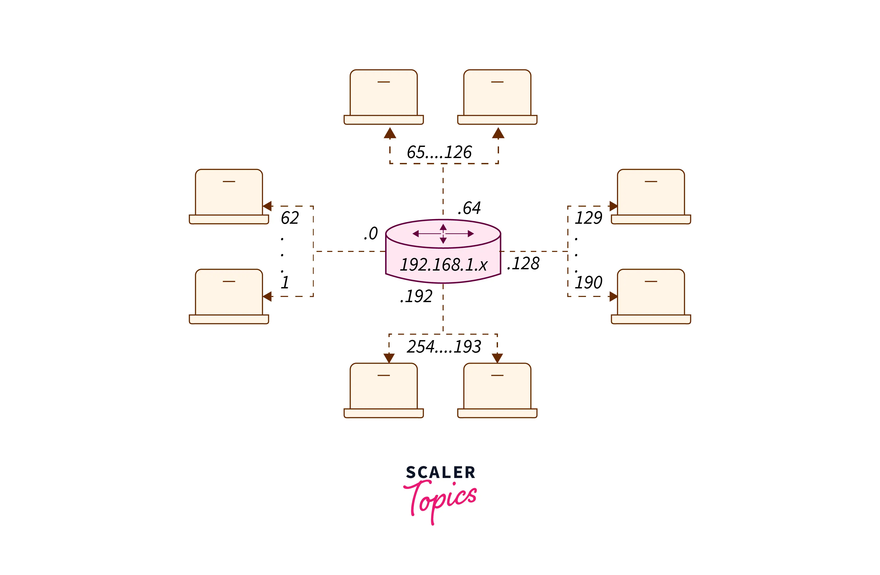
After subnetting, our network will look like this.

Slide 37
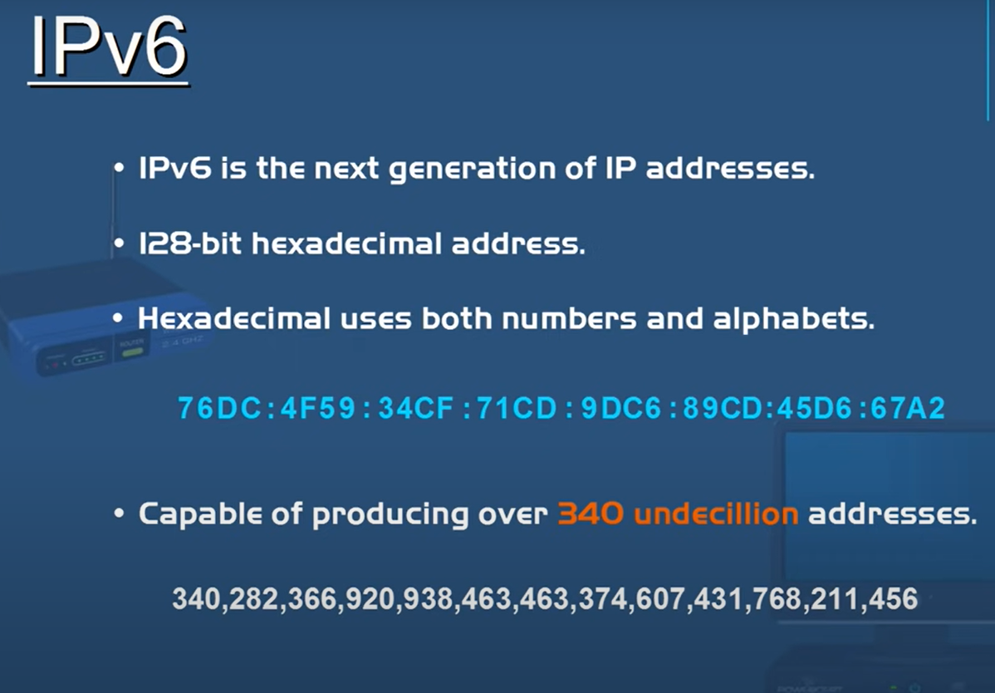

Slide 38
Format of an IPv6 address
In precise terms, an IPv6 address is 128 bits long and is arranged in eight groups, each of which 16 bits. Each group is expressed as four hexadecimal digits and the groups are separated by colons.
An example of a full IPv6 address could be:
FE80:CD00:0000:0CDE:1257:0000:211E:729C

Slide 39
IPv6 was developed by Internet Engineering Task Force (IETF) to deal with the problem of IPv4 exhaustion. IPv6 is a 128-bits address having an address space of 2¹²⁸, which is way bigger than IPv4. IPv6 use Hexa-Decimal format separated by colon (:) .
Components in Address format :
There are 8 groups and each group represents 2 Bytes (16-bits).
Each Hex-Digit is of 4 bits (1 nibble)
Delimiter used – colon (:)

Slide 40
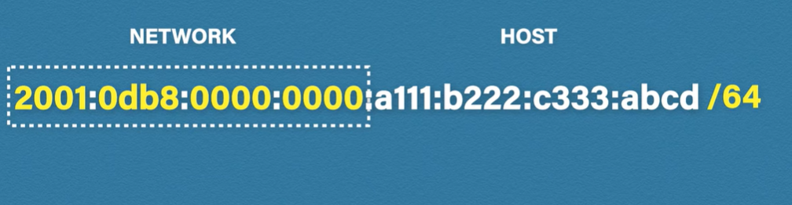
The network component is the first 64 bits of the address and is used for routing.
The node component is the later 64 bits and is used to identify the address of the interface.

Slide 41
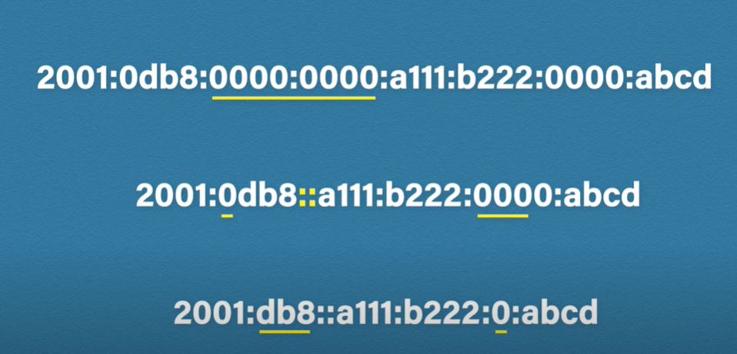

Slide 42
Addressing methods
1. Unicast Address Unicast Address identifies a single network interface. A packet sent to a unicast address is delivered to the interface identified by that address.
2. Multicast Address Multicast Address is used by multiple hosts, called as groups, acquires a multicast destination address.
3. Anycast Address Anycast Address is assigned to a group of interfaces. Any packet sent to an anycast address will be delivered to only one member interface

Slide 43
We have 128 bits in IPv6 address but by looking at the first few bits we can identify what type of address it is.
Parts of the IPv6 Address. An IPv6 address is 128 bits in length and consists of eight, 16-bit fields, with each field bounded by a colon.
Each field must contain a hexadecimal number, in contrast to the dotted-decimal notation of IPv4 addresses. In the next figure, the x's represent hexadecimal numbers.

Slide 44
The leftmost three fields (48 bits) contain the site prefix. The prefix describes the public topology that is usually allocated to your site by an ISP or Regional Internet Registry (RIR).
The next field is the 16-bit subnet ID, which you (or another administrator) allocate for your site. The subnet ID describes the private topology, also known as the site topology, because it is internal to your site.
The rightmost four fields (64 bits) contain the interface ID, also referred to as a token. The interface ID is either automatically configured from the interface's MAC address or manually configured in EUI-64 format.

Slide 45
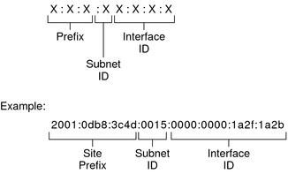
Basic IPv6 Address Format

Slide 46
Shift from IPv4 to IPv6
1. Large address space
An IPv6 address is 128 bits long .compared with the 32 bit address of IPv4, this is a huge(2 raised 96 times) increases in the address space.
2. Better header format
IPv6 uses a new header format in which options are separated from the base header and inserted, when needed, between the base header and the upper layer data .
3. Allowance for extension
IPv6 is designed to allow the extension of the protocol if required by new technologies or applications.
4. Support for more security
The encryption and authentication options in IPv6 provide confidentiality and integrity of the packet.

Slide 47
Routing Protocols

Slide 48
Introduction
Routing is a process in which the layer 3 devices (either router or layer 3 switches) find the optimal path to deliver a packet from one network to another.
Dynamic routing protocols use metric, cost, and hop count to identify the best path from the path available for the destination network.
A routing protocol specifies how routers communicate with each other to distribute information that enables them to select routes between nodes on a computer network.
Routing Protocols are the set of defined rules used by the routers to communicate between source & destination. They do not move the information to the source to a destination, but only update the routing table that contains the information.

Slide 49
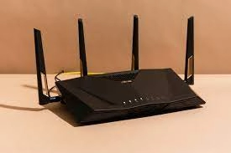
What is a Router?
A router is a piece of network hardware in charge of routing packets to their destinations. Routers connect to two or more IP networks or subnetworks and share the data packets as per the need. Routers are used in homes and offices to connect to local networks. We can find different kinds of routers based on their power found over the internet, which helps the data packets reach their destinations.

Slide 50
Routing table
In computer networking, a routing table, or routing information base (RIB), is a data table stored in a router or a network host that lists the routes to particular network destinations, and in some cases, metrics (distances) associated with those routes.
The routing table contains information about the topology of the network immediately around it.
A routing table is a table or database that stores the location of routers based on their IP addresses. This table acts as an address map to various networks, and is usually stored in the RAM of most routers or forwarding devices. As such, a routing table contains information about various networks, and how to get to them.

Slide 51
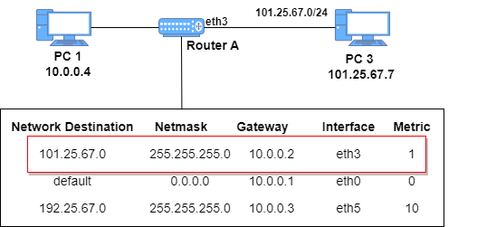
Example
Looking at the first entry below, suppose PC1 would like to send a packet to PC3 on the destination at 101.25.67.0.
However, PC3 is not on PC1’s network, so PC1 forwards this packet to Router A.
Upon arrival at Router A, the router checks its routing table for a path to destination 101.25.67.0:

Slide 52
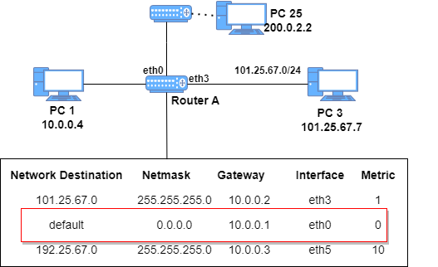
Now let’s consider the second entry. Suppose a user on PC1 wants to send a packet to PC25 on the network 200.0.2.0.
Router A will check its routing table for an entry to the address on which PC25 is located.
Since there is no recorded entry, Router A forwards this packet to the default gateway at 10.0.0.1 through the interface eth0 to other networks connected to it:

Slide 53
The default gateway route is always present in any routing table. It’s used when there is no entry for a specific network on the routing table.
The default gateway usually connects to other remote networks. For example, in a home environment, the default gateway is connected to the Internet.
In the third and final entry, just like the first entry, a packet addressed to destination 192.25.67.0 will be forwarded to the gateway at 10.0.0.3 through interface eth5:

Slide 54
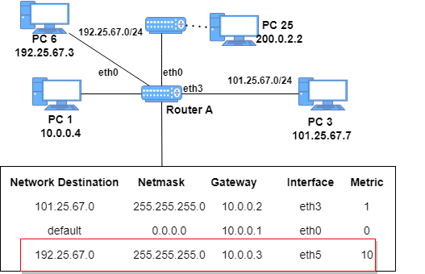

Slide 55
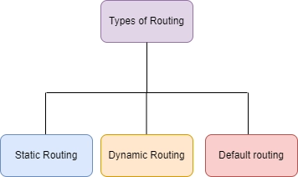
Types of Routing Protocols
There are mainly two types of Network Routing Protocols:
Static
Dynamic
Default Routing

Slide 56
Static Routing
Static routing is a process in which we have to manually add routes to the routing table. Another name for Static Routing is Nonadaptive Routing..
Let's suppose our computer wants to connect with another computer, and there are ten different networks between them. When we want to connect both the computers, we have to give the information manually about the networks through which we want to connect to the router, then only the exchange of data can be possible.
This process is said to be Static Routing.

Slide 57
In static routing, commands are manually configured by network administrator. The routes, which configured by using static routing are permanent routes. These routes will not changed until changed by manual configuration.
To configure static routing, we require network ID, subnet mask and next-hop address. Static routing is used for small organizations within a network of 10-15 routers. Static routes are fast and secure. AD value of static route is 1.
Configuring Static Route: There are two ways to configure static routing.
Router(config)# ip route <Destination Network ID> <Destination Subnet Mask> <Next-hop IP address >
Router(config)# ip route <Destination Network ID> <Destination Subnet Mask> <Exit interface type><interface number>

Slide 58
Configuration

Slide 59
Default routing
Default routing is configured only when destination is unknown. It is also configured manually.
Default routing path is least preferred path. When there is no entry for the destination network in a routing table, the router will forward the packet to its default route.
This is the method where the router is configured to send all packets toward a single router (next hop). It doesn’t matter to which network the packet belongs, it is forwarded out to the router which is configured for default routing. It is generally used with stub routers.

Slide 60
Dynamic Routing:
Dynamic routing makes automatic adjustments of the routes according to the current state of the route in the routing table.
Dynamic routing uses protocols to discover network destinations and the routes to reach them. Automatic adjustments will be made to reach the network destination if one route goes down.
A dynamic protocol has the following features:
The routers should have the same dynamic protocol running in order to exchange routes.
When a router finds a change in the topology then the router advertises it to all other router

Slide 61
In this topology, R1 and R2 are stub routers so we can configure default routing for both these routers.
Configuring default routing for R1:
R1(config)#ip route 0.0.0.0 0.0.0.0 172.16.10.5
Now configuring default routing for R2:
R2(config)#ip route 0.0.0.0 0.0.0.0 172.16.10.1

Slide 63
In dynamic routing, we configure a dynamic routing protocol that learns routes automatically and also when changes are happened in network updates the routing table accordingly.
For example for internal gateway routing (IGP), we use OSPF, EIGRP and IS-IS and for external gateway protocol (EGP) BGP is used.

Slide 64
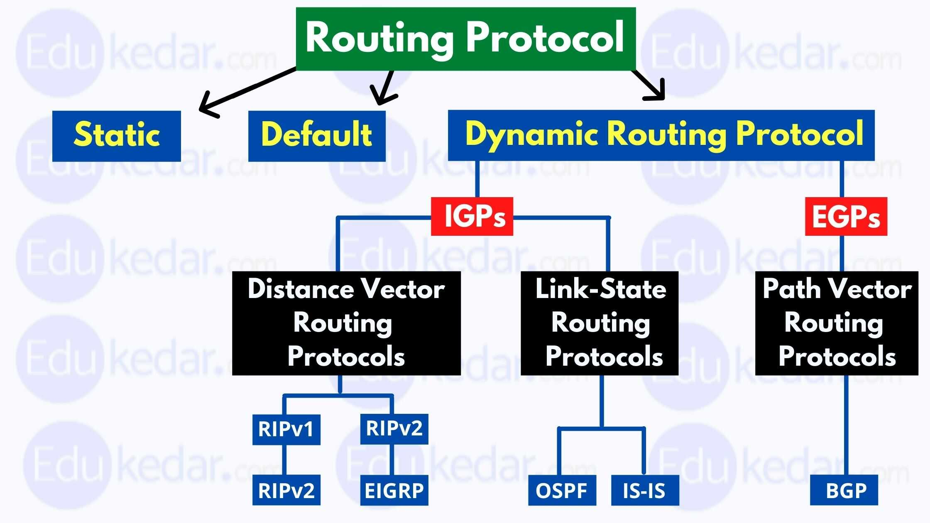
Routing protocols and types

Slide 65
There are three broad categories of dynamic routing protocols:
Distance-vector
Link-state
Hybrids

Slide 66
IP Routing

Slide 67
Autonomous Systems
An autonomous system is a region of the Internet that is administered by a single entity.
Examples of autonomous regions are:
UVA’s campus network
MCI’s backbone network
Regional Internet Service Provider
Routing is done differently within an autonomous system (intradomain routing) and between autonomous system (interdomain routing).

Slide 68
Autonomous Systems (AS)

Slide 71
Interdomain and Intradomain Routing
Intradomain Routing
Routing within an AS
Ignores the Internet outside the AS
Protocols for Intradomain routing are also called Interior Gateway Protocols or IGP’s.
Popular protocols are
RIP (simple, old)
OSPF (better)
Interdomain Routing
Routing between AS’s
Assumes that the Internet consists of a collection of interconnected AS’s
Normally, there is one dedicated router in each AS that handles interdomain traffic.
Protocols for interdomain routing are also called Exterior Gateway Protocols or EGP’s.
Routing protocols:
EGP
BGP (more recent)

Slide 72
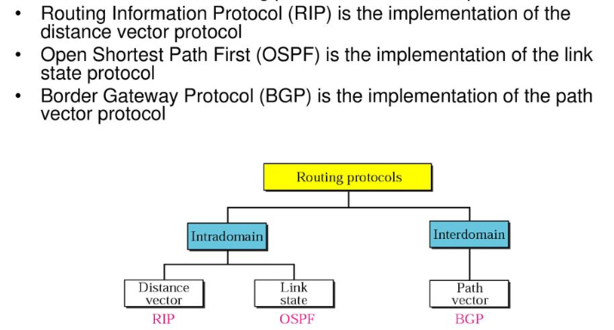

Slide 73
Routing Information Protocol (RIP)
RIP is a routing protocol for exchanging routing table information between routers.
Routing updates must be passed between routers so that they can make the proper choice on how to route a packet.
It is a very simple protocol based on distance vector routing based on hop count matrix
HOP Count
It refers to the intermediate devices (like routers) through which data must pass between source and destination, rather than following directly over a single wire (number of links).

Slide 74
When a router forward a packet to a network segment, its counted as a single hop.
The maximum number of hops allowed for RIP is 15 only.
A hop count of 16 is considered an infinite distance and used to deprecate inaccessible, inoperable, or other wise undesirable routes in the selection process.
Usually, each RIP router transmitted full updates for every 30 seconds.
If any of router got disconnected from the network, the neighbor router wait for 180 seconds to hear the update.
Flush timer is 240 seconds (router does not give any update with in 4mins, completely remove it from the network).

Slide 75
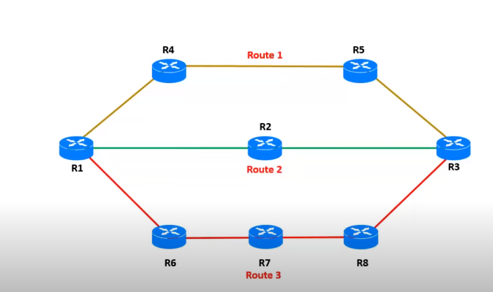

Slide 76
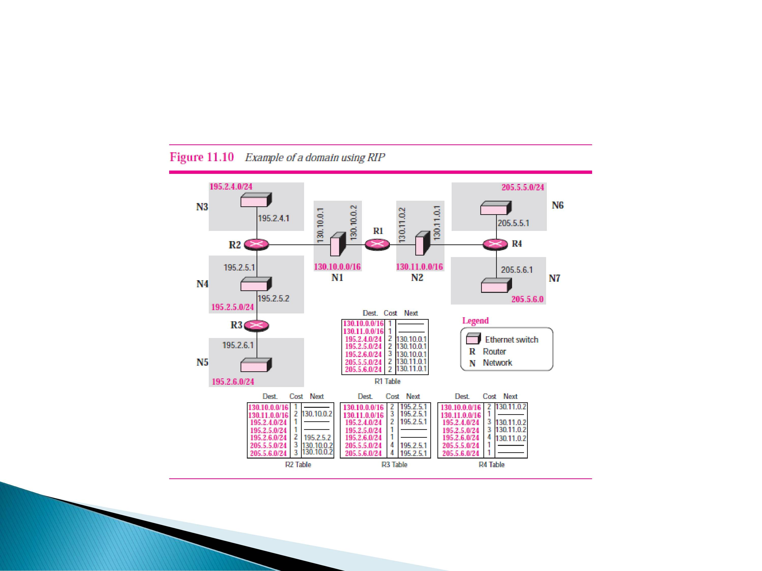

Slide 78
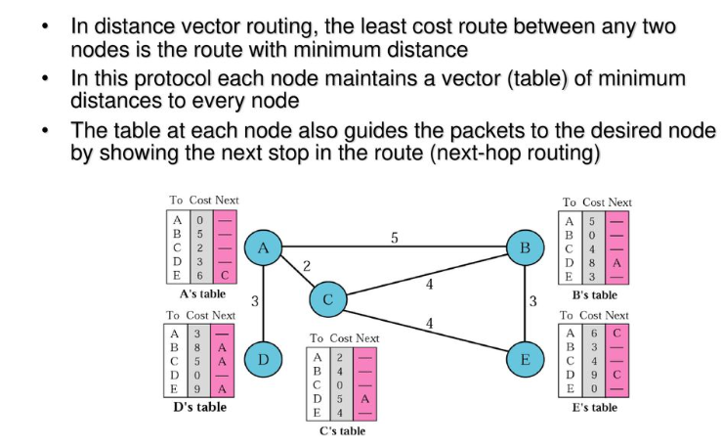

Slide 80
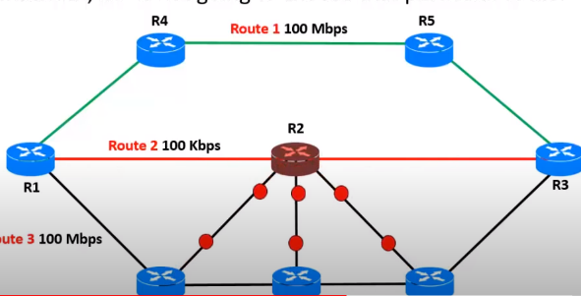
Drawbacks
Its only based on hop count matrix. So, if there is better route avaible with more bandwidth, RIP is not going to choose that particular path
RIP supports maximum 15 hops (0-15), maximum 16 routers can be configured.
BW utilization is high

Slide 82
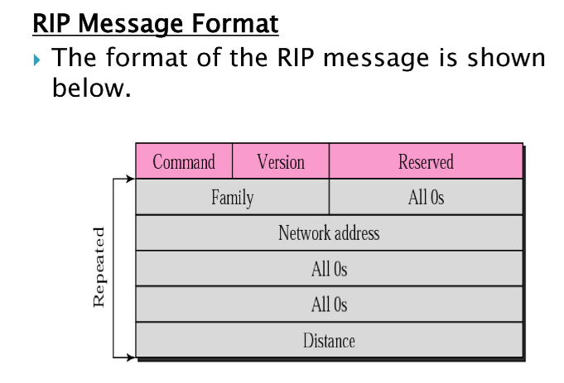

Slide 83
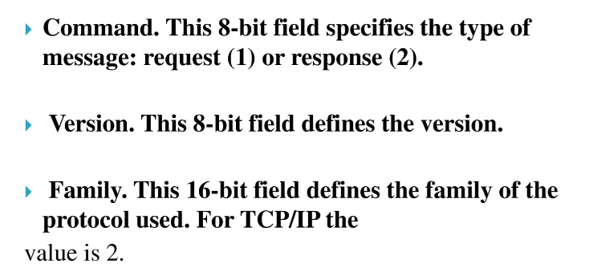

Slide 84
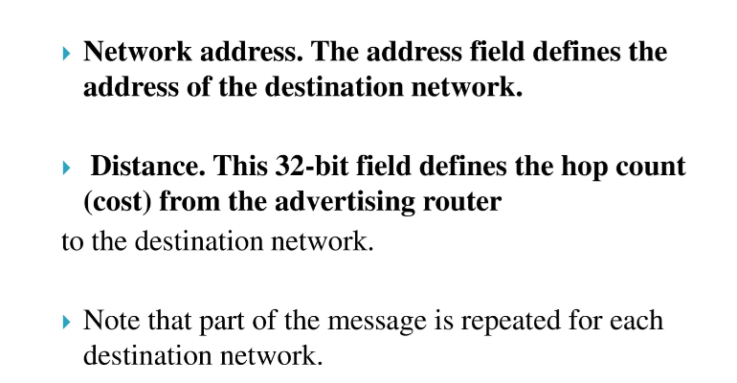

Slide 85
Distance Vector Algorithm: Routing Table
c(v,w): cost to transmit on the interface to network Net(v,w)
Net(v,w): Network address of the network between v and w The network can be a link, but could also be a LAN

Slide 86
Distance Vector Algorithm: Messages
Nodes send messages to their neighbors which contain routing table entries
A message has the format: [Net , D(v,Net)] means“My cost to go to Net is D (v,Net)”
[Net , D(v,Net)]
v
n

Slide 87
Distance Vector Algorithm: Sending Updates
Periodically, each node v sends the content of its routing table to its neighbors:

Slide 88
Initiating Routing Table I
Suppose a new node v becomes active.
The cost to access directly connected networks is zero:
D (v, Net(v,m)) = 0
D (v, Net(v,w)) = 0
D (v, Net(v,n)) = 0

Slide 89
Initiating Routing Table II
New node v sends the routing table entry to all its neighbors:

Slide 90
Initiating Routing Table III
Node v receives the routing tables from other nodes and builds up its routing table

Slide 91
Updating Routing Tables I
Suppose node v receives a message from node m: [Net,D(m,Net)]
Node v updates its routing table and sends out further messages if the message reduces the cost of a route:
if ( D(m,Net) + c (v,m) < D (v,Net) ) {
D^{new} (v,Net) := D (m,Net) + c (v,m); Update routing table;
send message [Net, D^{new} (v,Net)] to all neighbors
}

Slide 92
Updating Routing Tables II
Before receiving the message:
Suppose D (m,Net) + c (v,m) < D (v,Net):

Slide 93
Example
Assume: - link cost is 1, i.e., c(v,w) = 1 - all updates, updates occur simultaneously - Initially, each router only knows the cost of connected interfaces
10.0.1.0/24
10.0.2.0/24
10.0.3.0/24
10.0.4.0/24
10.0.5.0/24
.2
.1
.2
.1
.2
.1
.2
.1
Router A
Router B
Router C
Router D
Net via
cost
Net via
cost
Net via
cost
Net via
cost
t=0: 10.0.1.0 - 0 10.0.2.0 - 0
t=0: 10.0.2.0 - 0 10.0.3.0 - 0
t=0: 10.0.3.0 - 0 10.0.4.0 - 0
t=0: 10.0.4.0 - 0 10.0.5.0 - 0
t=1: 10.0.1.0 - 0 10.0.2.0 - 0 10.0.3.0 10.0.2.2 1
t=1: 10.0.1.0 10.0.2.1 1 10.0.2.0 - 0 10.0.3.0 - 0 10.0.4.0 10.0.3.2 1
t=1: 10.0.2.0 10.0.3.1 1 10.0.3.0 - 0 10.0.4.0 - 0 10.0.5.0 10.0.4.2 1
t=1: 10.0.3.0 10.0.4.1 1 10.0.4.0 - 0 10.0.5.0 - 0
t=2: 10.0.1.0 - 0 10.0.2.0 - 0 10.0.3.0 10.0.2.2 1 10.0.4.0 10.0.2.2 2
t=2: 10.0.1.0 10.0.2.1 1 10.0.2.0 - 0 10.0.3.0 - 0 10.0.4.0 10.0.3.2 1 10.0.5.0 10.0.3.2 2
t=2: 10.0.1.0 10.0.3.1 2
10.0.2.0 10.0.3.1 1 10.0.3.0 - 0 10.0.4.0 - 0 10.0.5.0 10.0.4.2 1
t=2: 10.0.2.0 10.0.4.1 2 10.0.3.0 10.0.4.1 1 10.0.4.0 - 0 10.0.5.0 - 0

Slide 94
Example
10.0.1.0/24
10.0.2.0/24
10.0.3.0/24
10.0.4.0/24
10.0.5.0/24
.2
.1
.2
.1
.2
.1
.2
.1
Router A
Router B
Router C
Router D
Net via
cost
Net via
cost
Net via
cost
Net via
cost
t=2: 10.0.1.0 - 0 10.0.2.0 - 0 10.0.3.0 10.0.2.2 1 10.0.4.0 10.0.2.2 2
t=2: 10.0.1.0 10.0.2.1 1 10.0.2.0 - 0 10.0.3.0 - 0 10.0.4.0 10.0.3.2 1 10.0.5.0 10.0.3.2 2
t=2: 10.0.1.0 10.0.3.1 2
10.0.2.0 10.0.3.1 1 10.0.3.0 - 0 10.0.4.0 - 0 10.0.5.0 10.0.4.2 1
t=2: 10.0.2.0 10.0.4.1 2 10.0.3.0 10.0.4.1 1 10.0.4.0 - 0 10.0.5.0 - 0
t=3: 10.0.1.0 - 0 10.0.2.0 - 0 10.0.3.0 10.0.2.2 1 10.0.4.0 10.0.2.2 2 10.0.5.0 10.0.2.2 3
t=3: 10.0.1.0 10.0.2.1 1 10.0.2.0 - 0 10.0.3.0 - 0 10.0.4.0 10.0.3.2 1 10.0.5.0 10.0.3.2 2
t=3: 10.0.1.0 10.0.3.1 2
10.0.2.0 10.0.3.1 1 10.0.3.0 - 0 10.0.4.0 - 0 10.0.5.0 10.0.4.2 1
t=3: 10.0.1.0 10.0.4.1 3 10.0.2.0 10.0.4.1 2 10.0.3.0 10.0.4.1 1 10.0.4.0 - 0 10.0.5.0 - 0
Now, routing tables have converged !

Slide 95
Characteristics of Distance Vector Routing
Periodic Updates: Updates to the routing tables are sent at the end of a certain time period. A typical value is 30 seconds.
Triggered Updates: If a metric changes on a link, a router immediately sends out an update without waiting for the end of the update period.
Full Routing Table Update: Most distance vector routing protocols send their neighbors the entire routing table (not only entries which change).
Route invalidation timers: Routing table entries are invalid if they are not refreshed. A typical value is to invalidate an entry if no update is received after 3-6 update periods.

Slide 96
The Count-to-Infinity Problem
A
1
B
1
C

Slide 97
Count-to-Infinity
The reason for the count-to-infinity problem is that each node only has a “next-hop-view”
For example, in the first step, A did not advertise that its route (with cost 2) to C went through node B
How can the Count-to-Infinity problem be solved?

Slide 98
Count-to-Infinity
The reason for the count-to-infinity problem is that each node only has a “next-hop-view”
For example, in the first step, A did not realize that its route (with cost 2) to C went through node B
How can the Count-to-Infinity problem be solved?
Solution 1: Always advertise the entire path in an update message (Path vectors)
If routing tables are large, the routing messages require substantial bandwidth
BGP uses this solution

Slide 99
Count-to-Infinity
The reason for the count-to-infinity problem is that each node only has a “next-hop-view”
For example, in the first step, A did not realize that its route (with cost 2) to C went through node B
How can the Count-to-Infinity problem be solved?
Solution 2: Never advertise the cost to a neighbor if this neighbor is the next hop on the current path (Split Horizon)
Example: A would not send the first routing update to B, since B is the next hop on A’s current route to C
Split Horizon does not solve count-to-infinity in all cases!

Slide 100
RIP - Routing Information Protocol
A simple intradomain protocol
Straightforward implementation of Distance Vector Routing
Each router advertises its distance vector every 30 seconds (or whenever its routing table changes) to all of its neighbors
RIP always uses 1 as link metric
Maximum hop count is 15, with “16” equal to “∞”
Routes are timeout (set to 16) after 3 minutes if they are not updated

Slide 101
RIP - History
Late 1960s : Distance Vector protocols were used in the ARPANET
Mid-1970s: XNS (Xerox Network system) routing protocol is the precursor of RIP in IP (and Novell’s IPX RIP and Apple’s routing protocol)
1982 Release of routed for BSD Unix
1988 RIPv1 (RFC 1058) - classful routing
1993 RIPv2 (RFC 1388) - adds subnet masks with each route entry - allows classless routing
1998 Current version of RIPv2 (RFC 2453)

Slide 102
RIPv1 Packet Format
1: RIPv1
1: request 2: response
2: for IP
0…0: request full rou-ting table
Address of destination
Cost (measured in hops)
One RIP message can have up to 25 route entries

Slide 103
RIPv2
RIPv2 is an extends RIPv1:
Subnet masks are carried in the route information
Authentication of routing messages
Route information carries better next-hop address if it exists
Exploites IP multicasting
Extensions of RIPv2 are carried in unused fields of RIPv1 messages

Slide 104
RIPv2 Packet Format
2: RIPv2
1: request 2: response
2: for IP
0…0: request full rou-ting table
Address of destination
Cost (measured in hops)
One RIP message can have up to 25 route entries

Slide 105
RIPv2 Packet Format
2: RIPv2
Used to carry information from other routing protocols (e.g., autonomous system number)
Subnet mask for IP address
Identifies a better next-hop address on the same subnet than the advertising router, if one exists (otherwise 0….0)

Slide 106
RIP Messages
This is the operation of RIP in routed. Dedicated port for RIP is UDP port 520.
Two types of messages:
Request messages
used to ask neighboring nodes for an update
Response messages
contains an update

Slide 107
Routing with RIP
Initialization: Send a request packet (command = 1, address family=0..0) on all interfaces:
RIPv1 uses broadcast if possible,
RIPv2 uses multicast address 224.0.0.9, if possible
requesting routing tables from neighboring routers
Request received: Routers that receive above request send their entire routing table
Response received: Update the routing table
Regular routing updates: Every 30 seconds, send all or part of the routing tables to every neighbor in an response message
Triggered Updates: Whenever the metric for a route change, send entire routing table.

Slide 108
RIP Security
Issue: Sending bogus routing updates to a router
RIPv1: No protection
RIPv2: Simple authentication scheme
2: plaintext password

Slide 109
RIP Problems
RIP takes a long time to stabilize
Even for a small network, it takes several minutes until the routing tables have settled after a change
RIP has all the problems of distance vector algorithms, e.g., count-to-Infinity
RIP uses split horizon to avoid count-to-infinity
The maximum path in RIP is 15 hops

Slide 110
RIP Problems
RIP takes a long time to stabilize
Even for a small network, it takes several minutes until the routing tables have settled after a change
RIP has all the problems of distance vector algorithms, e.g., count-to-Infinity
RIP uses split horizon to avoid count-to-infinity
The maximum path in RIP is 15 hops

Slide 111
OSPF Protocol
The OSPF stands for Open Shortest Path First. Open Shortest Path First (OSPF) is a link-state routing protocol that is used to find the best path between the source and the destination router using its own Shortest Path First.
It is an intradomain protocol, which means that it is used within an area or a network.It is an interior gateway protocol.
The OSPF achieves by learning about every router and subnet within the entire network. Every router contains the same information about the network.
The way the router learns this information by sending LSA (Link State Advertisements).
These LSAs contain information about every router, subnet, and other networking information. Once the LSAs have been flooded, the OSPF stores the information in a link-state database known as LSDB.

Slide 112
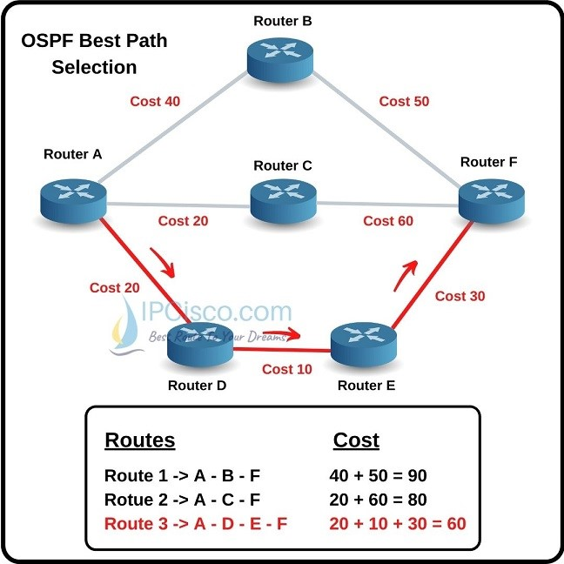

Slide 113
OSPF divides the autonomous systems into areas where the area is a collection of networks, hosts, and routers.
Like internet service providers divide the internet into a different autonomous system for easy management and OSPF further divides the autonomous systems into Areas.
In Area, the special router also exists. The special routers are those that are present at the border of an area, and these special routers are known as Area Border Routers. This router summarizes the information about an area and shares the information with other areas.
OSPF was developed so that the shortest path through a network was calculated based on the cost of the route. This cost value is derived from bandwidth values in the path. Therefore, OSPF undertakes route cost calculation on the basis of link-cost parameters, which you can control by manipulating the cost calculation formula.

Slide 114
How does OSPF work?
Step 1: The first step is to become OSPF neighbors. The two connecting routers running OSPF on the same link creates a neighbor relationship.
Step 2: The second step is to exchange database information.
Step 3: The third step is to choose the best route.

Slide 115
Types of links in OSPF
There are four types of links in OSPF:
Point-to-point link: The point-to-point link directly connects the two routers without any host or router in between.
Transient link: When several routers are attached in a network, they are known as a transient link.
Stub link: It is a network that is connected to the single router. Data enters to the network through the single router and leaves the network through the same router.
Virtual link: If the link between the two routers is broken, the administration creates the virtual path between the routers, and that path could be a long one also.

Slide 116
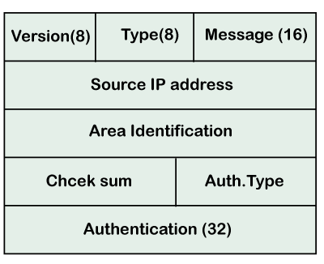
Version: It is an 8-bit field that specifies the OSPF protocol version.
Type: It is an 8-bit field. It specifies the type of the OSPF packet.
Message: It is a 16-bit field that defines the total length of the message, including the header. Therefore, the total length is equal to the sum of the length of the message and header.
Source IP address: It defines the address from which the packets are sent. It is a sending routing IP address.
Area identification: It defines the area within which the routing takes place.
Checksum: It is used for error correction and error detection.
Authentication type: There are two types of authentication, i.e., 0 and 1. Here, 0 means for none that specifies no authentication is available and 1 means for pwd that specifies the password-based authentication.
Authentication: It is a 32-bit field that contains the actual value of the authentication data.

Slide 117
OSPF Packets
There are five different types of packets in OSPF:
Hello
Database Description
Link state request
Link state update
Link state Acknowledgment
Hello packet
The Hello packet is used to create a neighborhood relationship and check the neighbor's reachability.
Database Description
After establishing a connection, if the neighbor router is communicating with the system first time, it sends the database information about the network topology to the system
Link state request
The link-state request is sent by the router to obtain the information of a specified route.
Link state update
The link-state update is used by the router to advertise the state of its links.
Link state acknowledgment
The link-state acknowledgment makes the routing more reliable by forcing each router to send the acknowledgment on each link state update.

